Slide 1
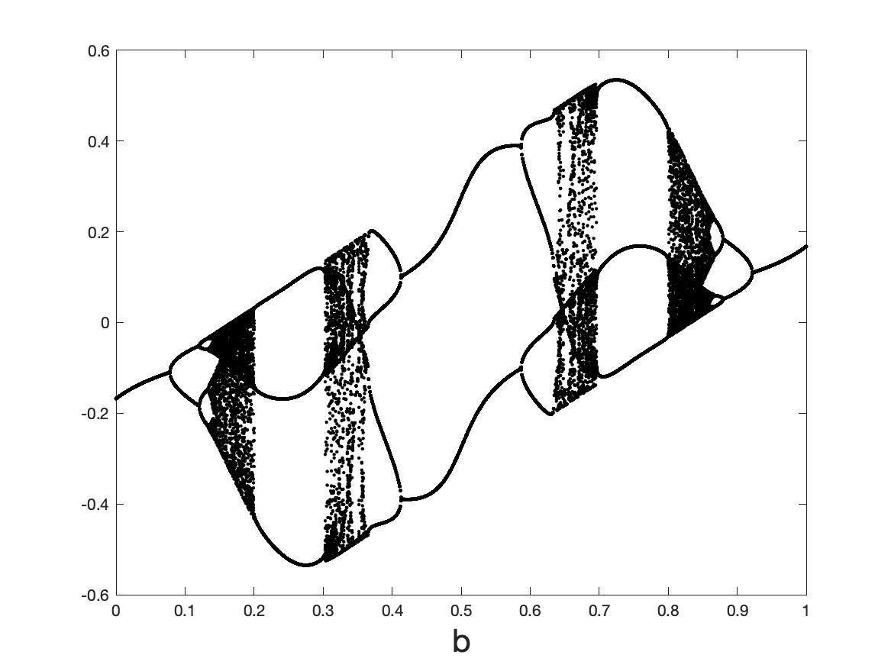


Lecture 7. Neural ODES for and as dynamical systems
Chris Budd OBE (Bath)

Slide 2
Some papers/books to look at
Chen et. al., Neural Ordinary Differential Equations
Matlab and Simulink, Dynamical System Modelling Using Neural ODE
di Bernardo et. al., Piecewise smooth dynamical systems
Brunton, Kutz et. al, Discovering governing equations from data by sparse identification of nonlinear dynamical systems
Ashwin et. al. RNNS

Slide 3
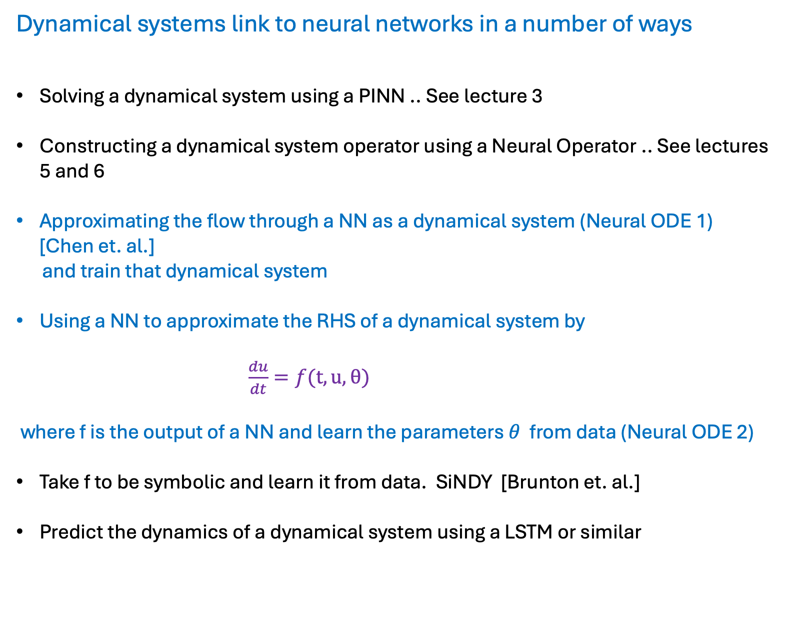
Dynamical systems link to neural networks in a number of ways
Solving a dynamical system using a PINN .. See lecture 3
Constructing a dynamical system operator using a Neural Operator .. See lectures 5 and 6
Approximating the flow through a NN as a dynamical system (Neural ODE 1) [Chen et. al.]
and train that dynamical system
Using a NN to approximate the RHS of a dynamical system by
$\frac{du}{dt}=f(t,u,θ)$
where f is the output of a NN and learn the parameters $θ$ from data (Neural ODE 2)
Take f to be symbolic and learn it from data. SiNDY [Brunton et. al.]
Predict the dynamics of a dynamical system using a LSTM or similar

Slide 4
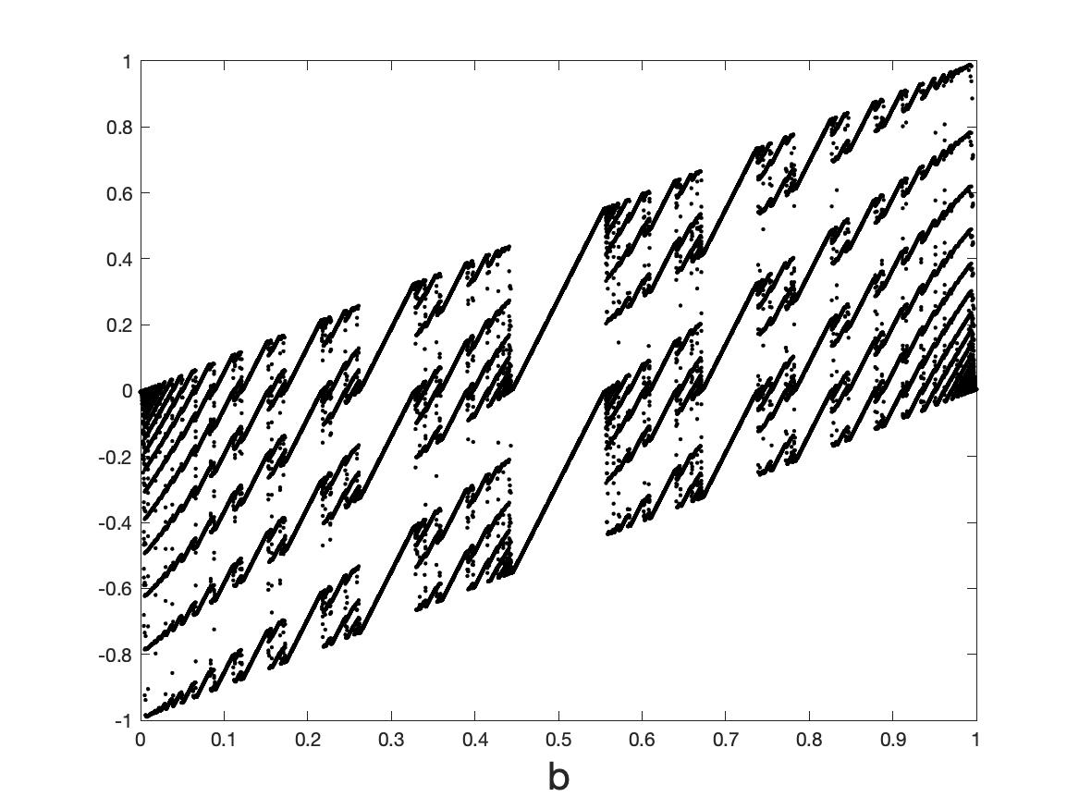
AIM:
Understand, and control, the dynamical behaviour and training of (feed forward) Neural Nets and Neural ODEs by using results from the theory of
dynamical systems (smooth and non-smooth)

Slide 5
Part 1: Smooth dynamical systems
Flows:
Maps:
Usual assumption:
The function f(. ) depends smoothly on all of its arguments

Slide 6
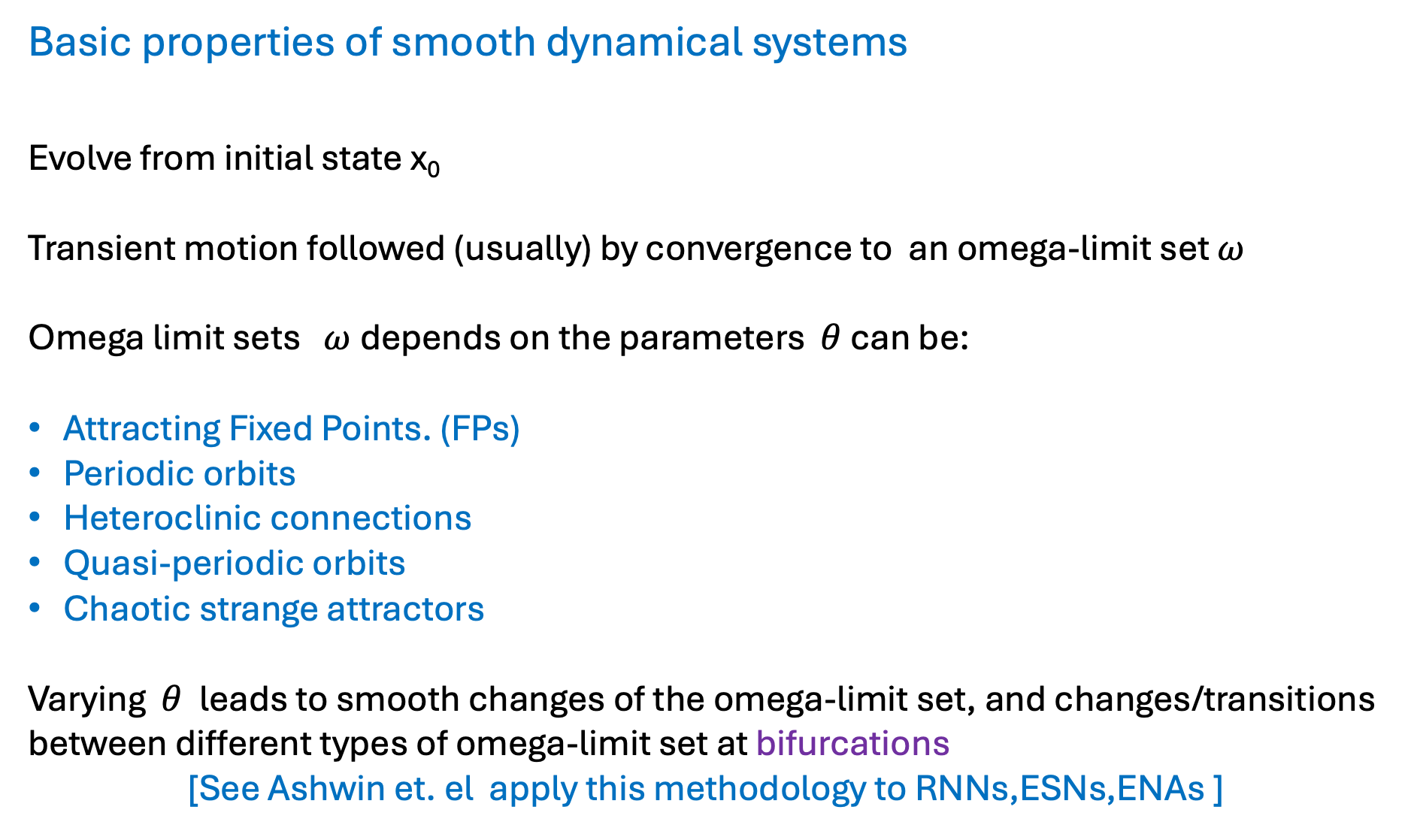
Basic properties of smooth dynamical systems
Evolve from initial state x₀
Transient motion followed (usually) by convergence to an omega-limit set $ω$
Omega limit sets $ω$depends on the parameters $θ$ can be:
Attracting Fixed Points. (FPs)
Periodic orbits
Heteroclinic connections
Quasi-periodic orbits
Chaotic strange attractors
Varying $θ$ leads to smooth changes of the omega-limit set, and changes/transitions between different types of omega-limit set at bifurcations
[See Ashwin et. el apply this methodology to RNNs,ESNs,ENAs ]

Slide 7
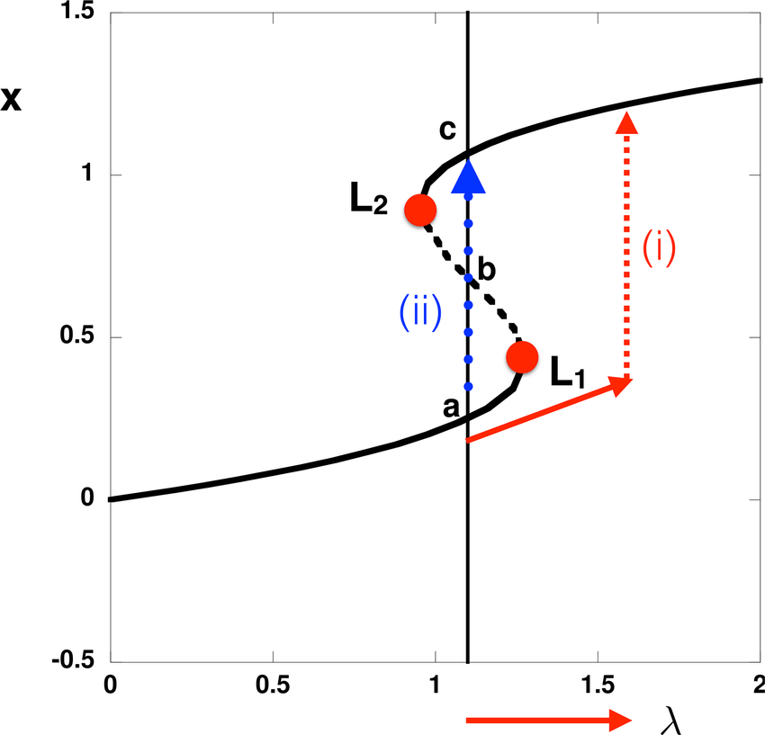
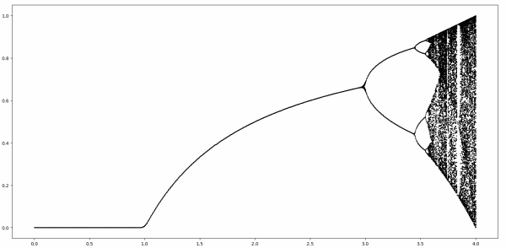
Examples of smooth bifurcations:
Saddle node and tipping points
Transcritical and Pitchfork (super and sub critical)
Period-doubling (and period doubling cascade to chaos)
Hopf (super and sub critical)
Cyclic fold
Homoclinic/heteroclinic

Slide 8
A. NNs as Dynamical Systems
All feed forward NNs and RNNs can be thought of as maps:
Eg.
Defines a map
NN: Input x_0 output x_N .
Deep if N >>1. Then we can study the output of the NN as the omega limit set of the map. Training then relates to how the omega limit set depends on the parameters eg. bifurcations etc.

Slide 9

Special case [Chen et. al] : The ResNET architecture
Let t = $n Δt$
Let $∆t →0$
Neural ODE. Input: x(0). Output: x(T), T = $n Δt$

Slide 10
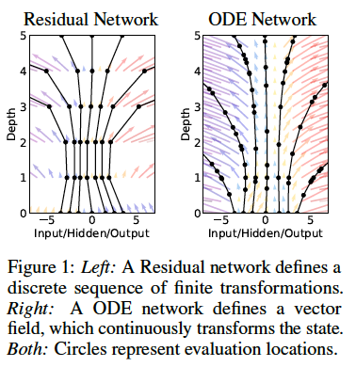
Idea [Chen et. al.]:
Replace the NN by solving the Neural ODE using an ODE solver eg. RK4
Training now becomes a question of finding the functions A(t), b(t), c(t)
Advantages in memory efficiency and back propagation
This a problem in optimal control theory

Slide 11
Example:

Slide 12
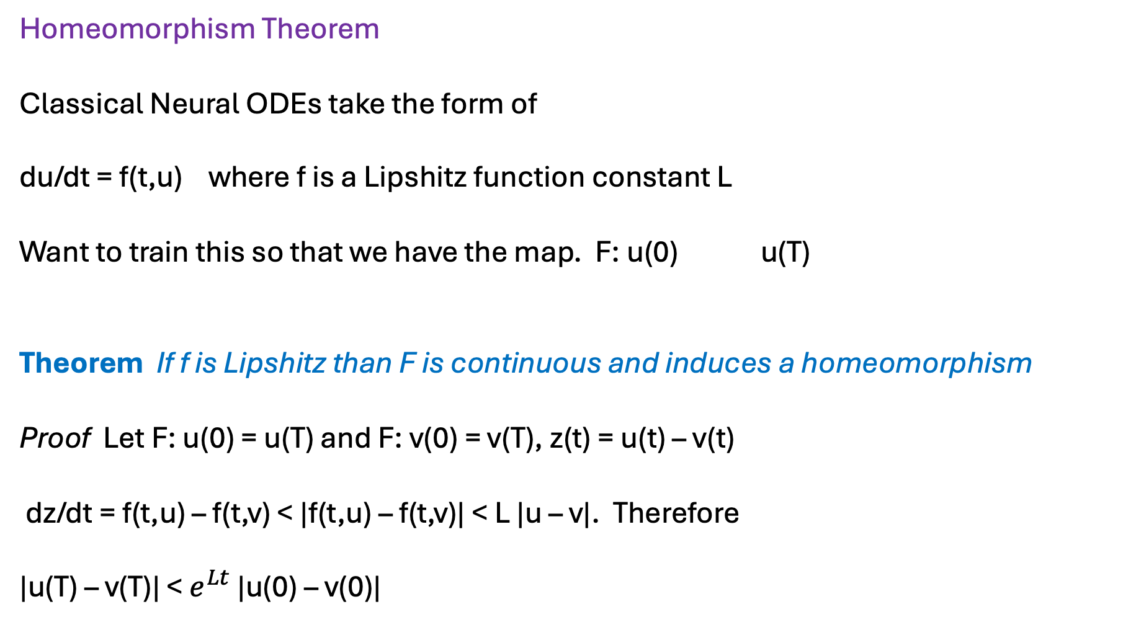
Homeomorphism Theorem
Classical Neural ODEs take the form of
du/dt = f(t,u) where f is a Lipshitz function constant L
Want to train this so that we have the map. F: u(0) u(T)
Theorem If f is Lipshitz than F is continuous and induces a homeomorphism
Proof Let F: u(0) = u(T) and F: v(0) = v(T), z(t) = u(t) – v(t)
dz/dt = f(t,u) – f(t,v) < |f(t,u) – f(t,v)| < L |u – v|. Therefore
|u(T) – v(T)| < $e^{Lt}$ |u(0) – v(0)|

Slide 13


Example: Want to train a Neural ODE to separate data
eg. dogs and cats
Can resolve this topology with a Neural ODE

Slide 14
But this data topology cannot be resolved using a Neural ODE
Have to either use a MAP or a non-Lipshitz Neural ODE

Slide 16
B: Dynamical systems as NNs
Can also simulate dynamics using a NN
Eg. Original DS is:
Train a NN to approximate this dynamics via:
Also (and confusingly) called a Neural ODE eg. by Matlab

Slide 17
Big literature on this
Echo State Networks, Reservoir networks .. Especially good for chaotic dynamics
SinDY approach (Kutze) using a very careful choice of RHS
Ptolemeic model of the solar system

Slide 18
Non-smooth dynamical systems
Flows:
Maps:
The function f(. ) is a non-smooth function of its arguments
(or a slightly regularized version of a non-smooth function)

Slide 19
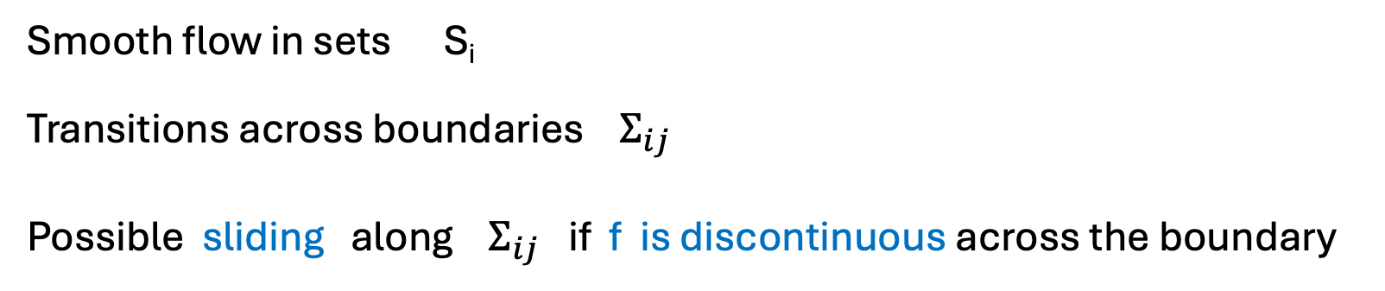
Examples:
Filippov Flows
Smooth flow in sets S_{i}
Transitions across boundaries $Σ_{ij}$
Possible sliding along $Σ_{ij}$ if f is discontinuous across the boundary

Slide 20
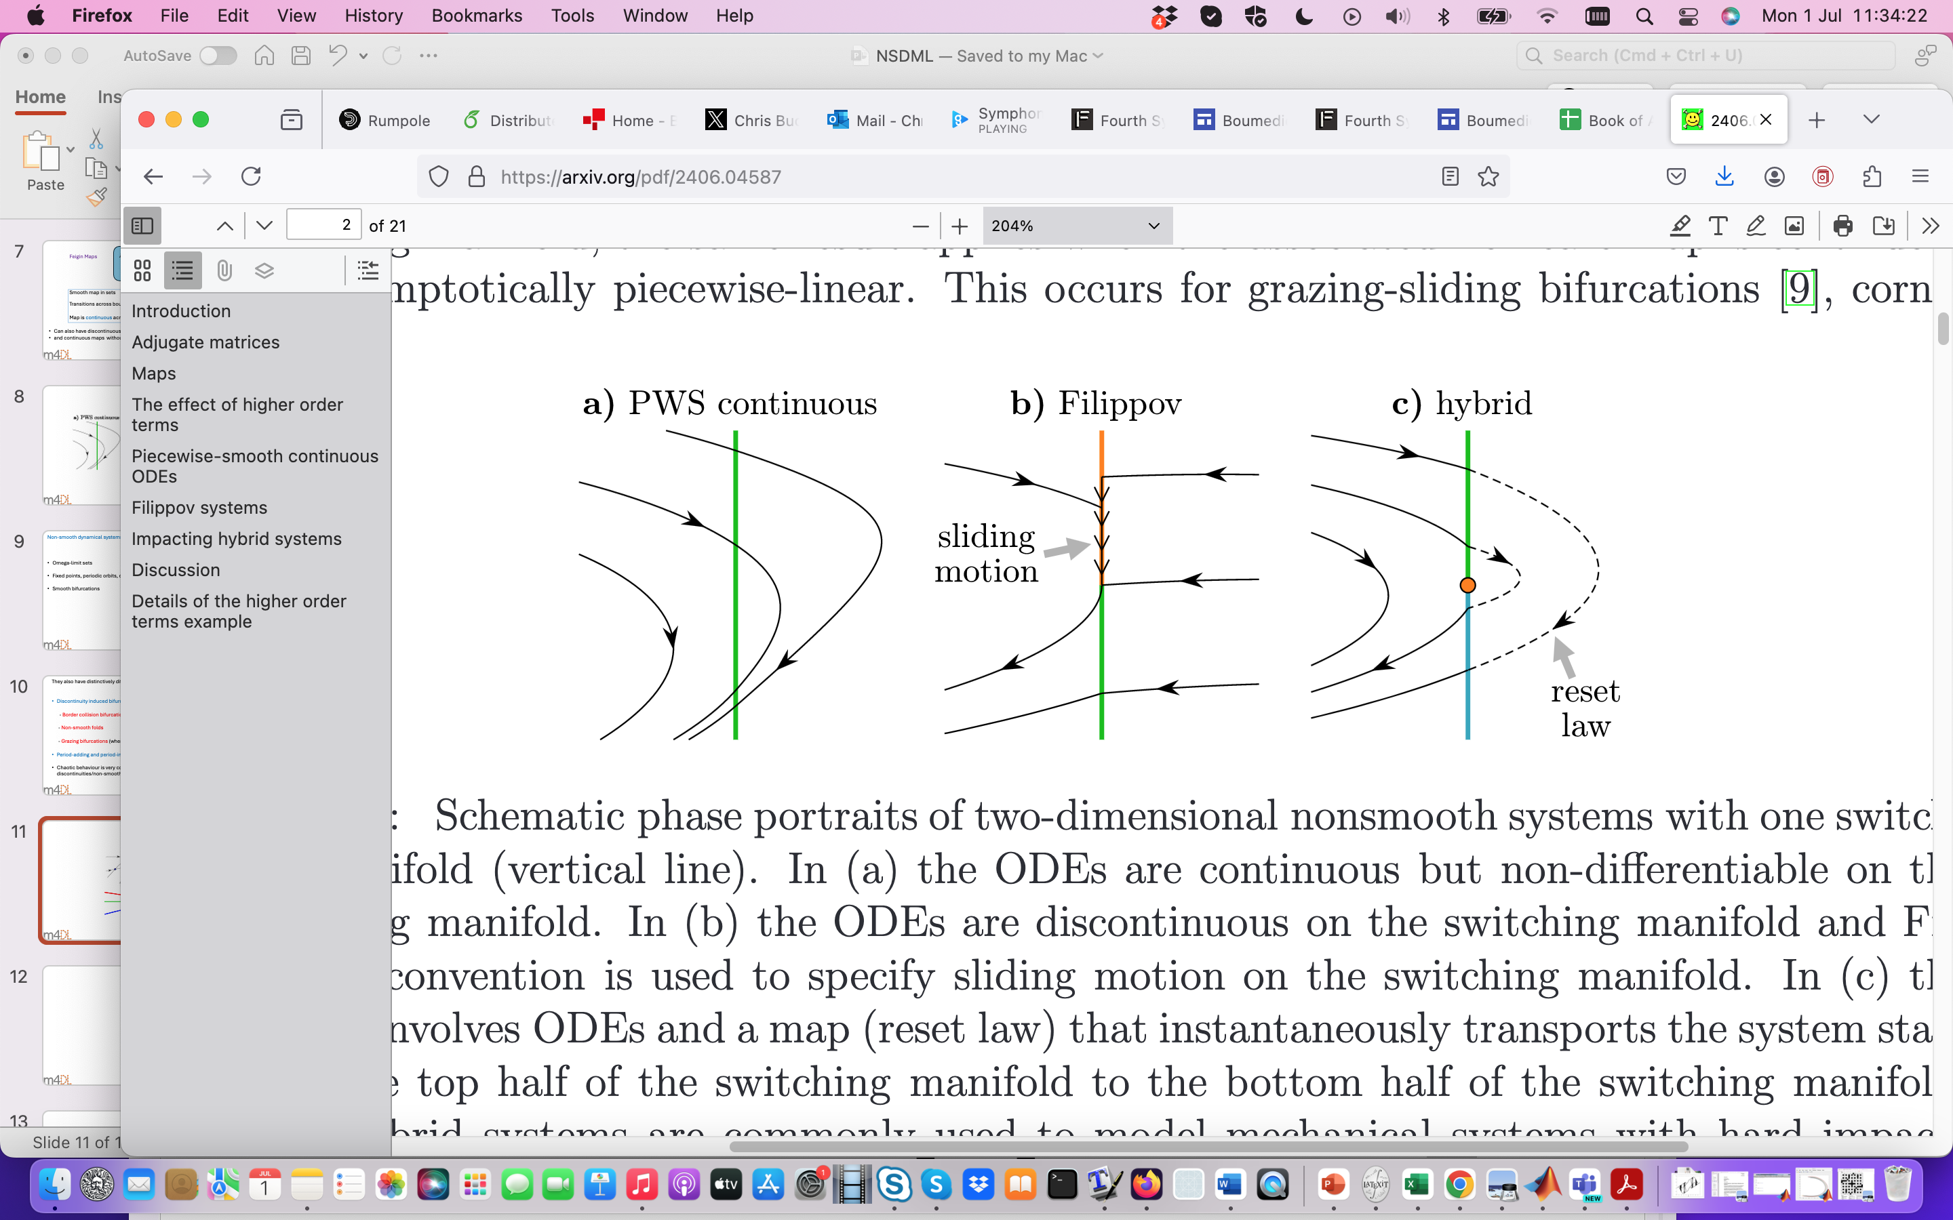

Slide 21

Feigin Maps
Smooth map in sets S_{i}
Transitions across boundaries/switching manifold $Σ_{ij}$
Map is continuous across $Σ_{ij}$and has one-sided derivatives
Can also have discontinuous maps (maps with a gap)
and continuous maps without one-sided derivatives (eg. square-root maps)

Slide 22
Non-smooth dynamical systems share many features with smooth ones
Omega-limit sets
Fixed points, periodic orbits, chaos
Smooth bifurcations

Slide 23
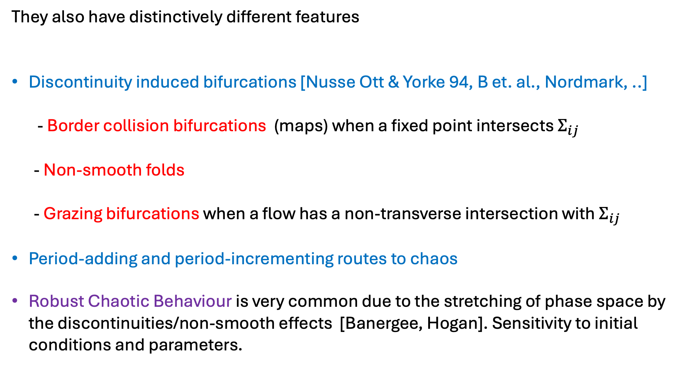
They also have distinctively different features
Discontinuity induced bifurcations [Nusse Ott & Yorke 94, B et. al., Nordmark, ..]
- Border collision bifurcations (maps) when a fixed point intersects $Σ_{ij}$
- Non-smooth folds
- Grazing bifurcations when a flow has a non-transverse intersection with $Σ_{ij}$
Period-adding and period-incrementing routes to chaos
Robust Chaotic Behaviour is very common due to the stretching of phase space by the discontinuities/non-smooth effects [Banergee, Hogan]. Sensitivity to initial conditions and parameters.

Slide 24
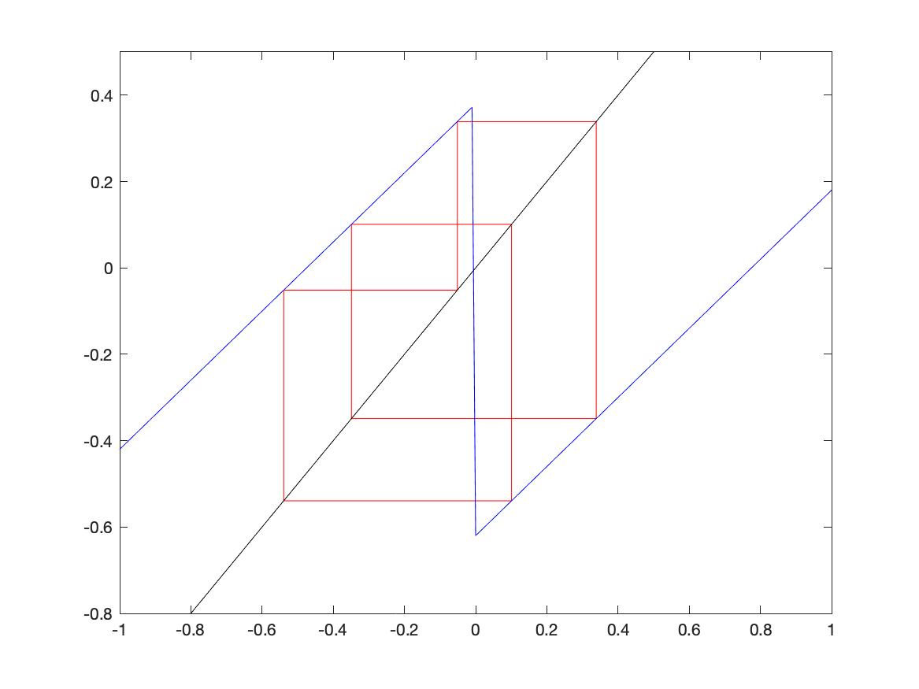
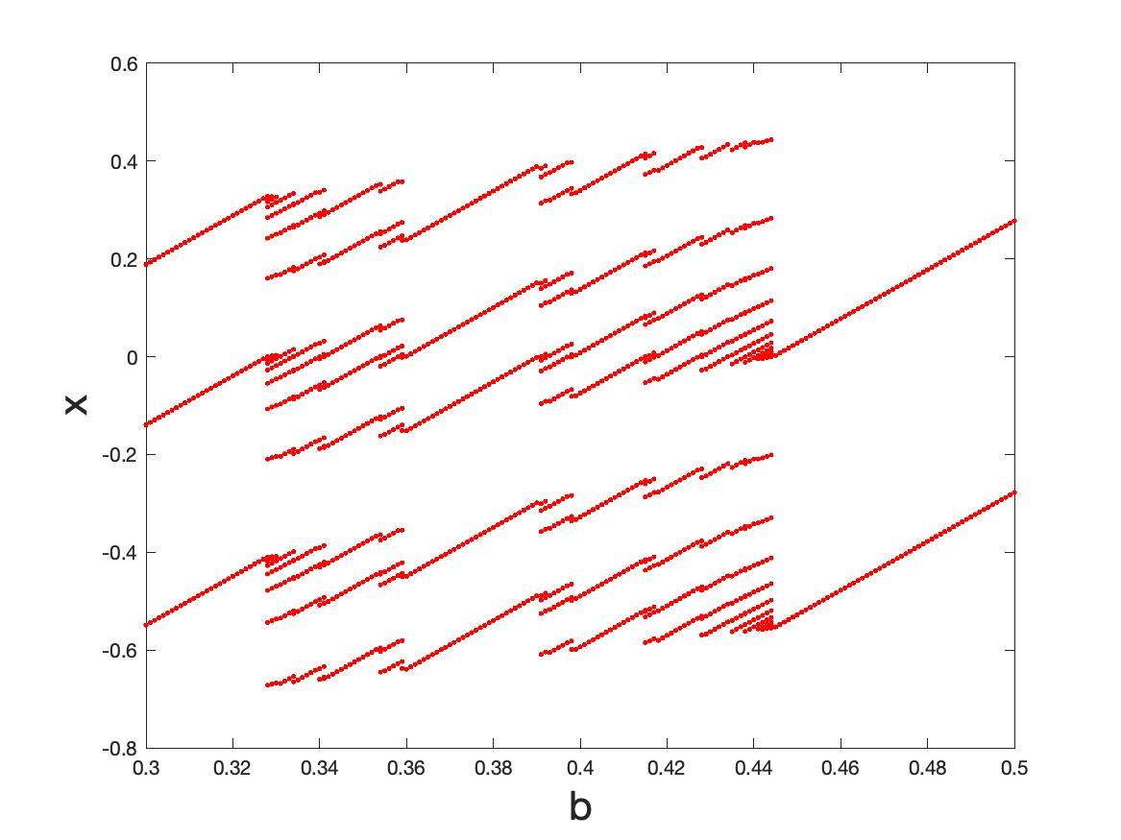
Eg. Periodic behaviour in an iterated map with a gap (almost a circle map)
Close to discontinuity
7
3
8
5
2
Border collision
Period 5 at b = 0.38
Period adding

Slide 25
Full Period-adding behaviour
8
5
8
3
7
5
7
2
8
5
3

Slide 26
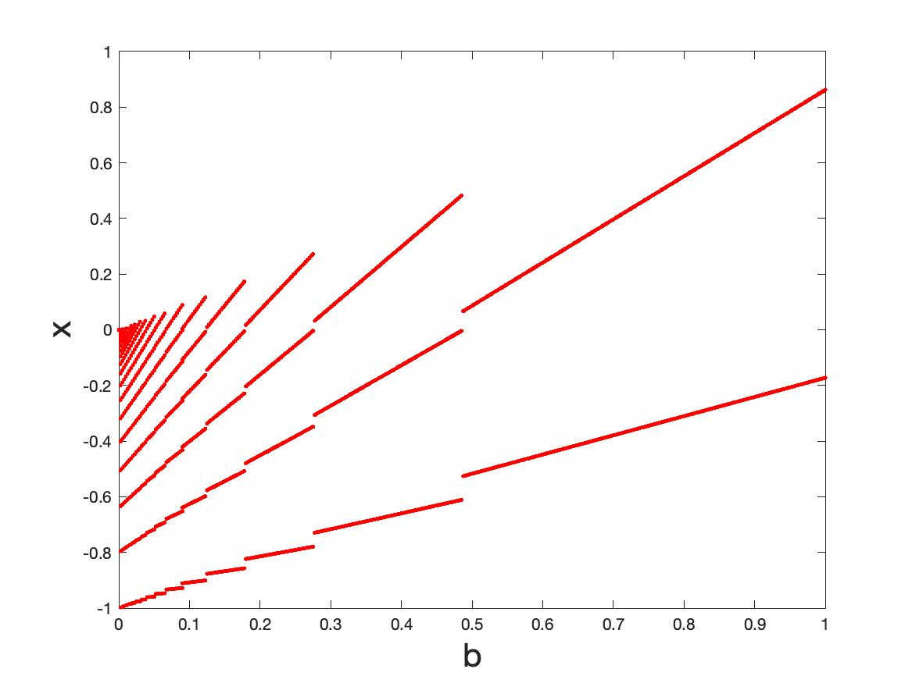
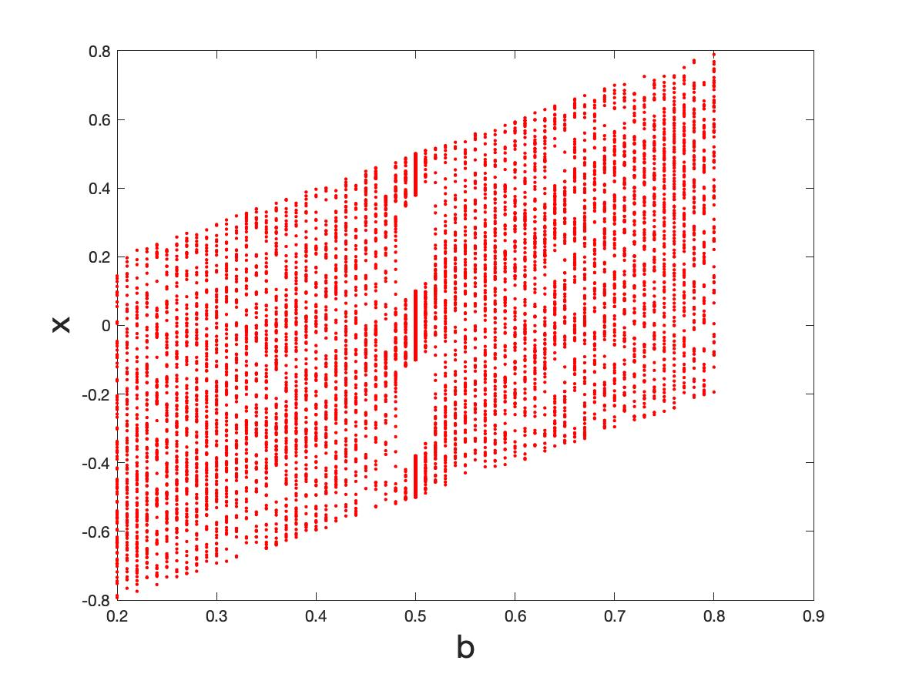
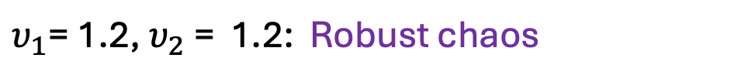
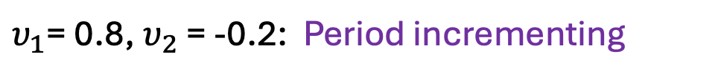
$υ_{1}$= 0.8,$υ_{2}$ = -0.2: Period incrementing
$υ_{1}$= 1.2,$υ_{2}$ = 1.2: Robust chaos

Slide 27
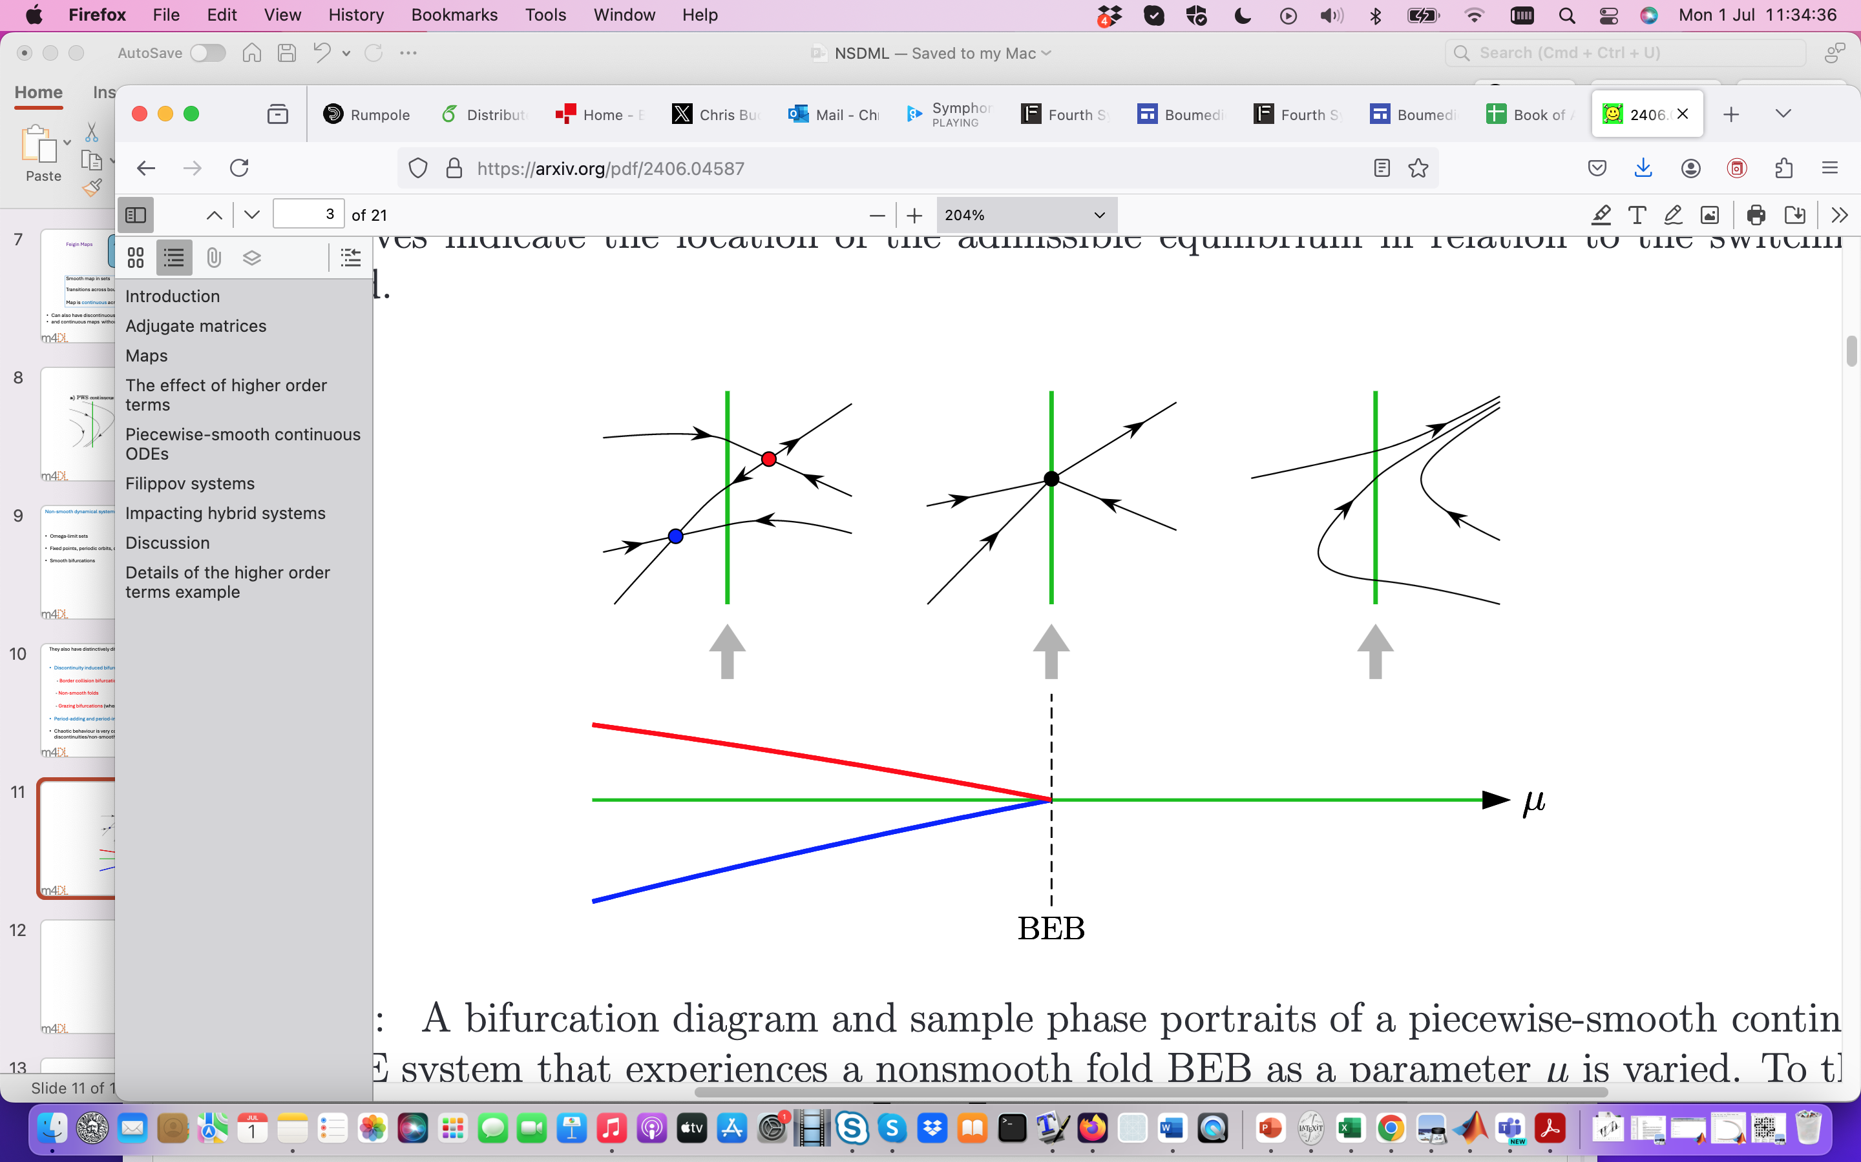
Flows: Non-smooth fold (boundary equilibrium bifurcation)

Slide 28
Applications of non-smooth dynamics
Mechanical systems with impact and friction
Electronic systems with switching
Neuro-science
Biological system eg. Sleep models
Climate models eg. ice-ages, AMOC
Any system with very disparate time/length scales
Machine learning
Rapid tipping at a non-smooth fold

Slide 29
Possible applications of NSD in machine learning
(architectures, dynamics and training)
Example One: Basic feed forward (ResNet) architecture as a non-smooth map
Input: x₀ Output: x_{L}
Discrete dynamical system.
If deep with L >> 1 then the output is on the omega-limit set

Slide 30

Non-smooth behaviour is introduced through the activation function
Discontinuous
Smoothed discontinuous
Discontinuous derivative
Discontinuous derivative

Slide 31
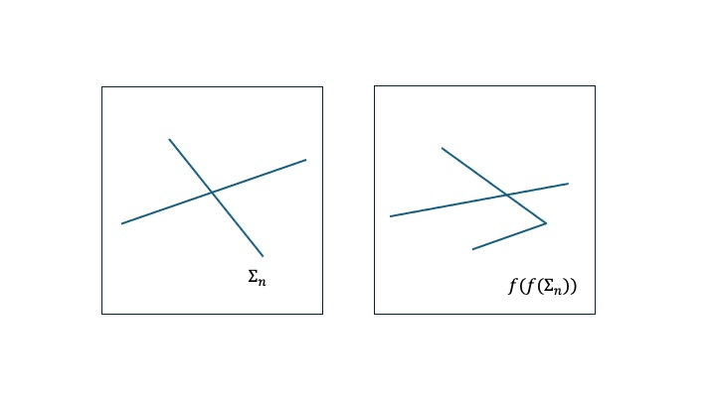
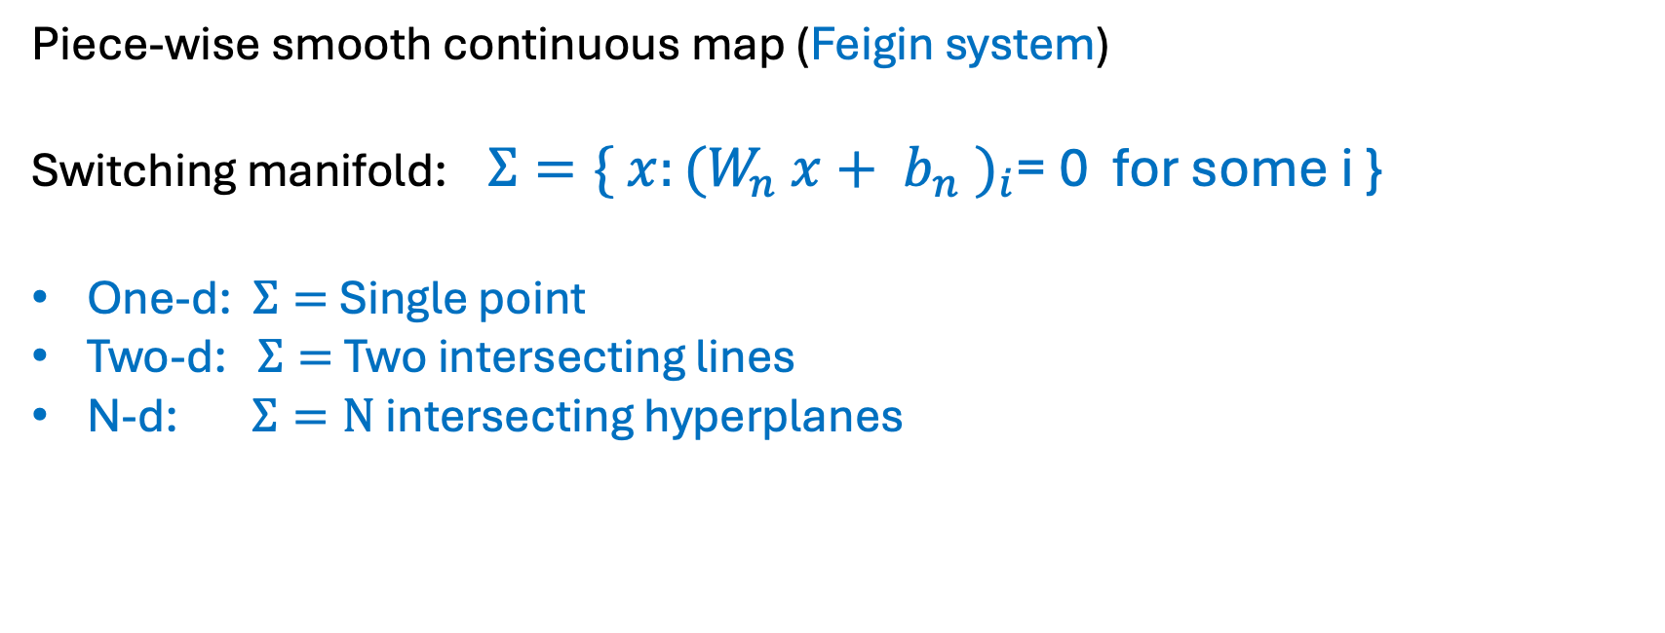
ReLU as a special case:
Piece-wise smooth continuous map (Feigin system)
Switching manifold: $Σ=\{ x:(W_{n} x+ b_{n} )_{i}$= 0 for some i }
One-d: $Σ=$Single point
Two-d: $Σ=$Two intersecting lines
N-d: $Σ=N$ intersecting hyperplanes

Slide 32
Example 2: ‘Neural ODE’
f(.) output of a feed-forward Neural Network
f(.) Can be piecewise smooth continuous or even discontinuous from previous analysis
Non-smooth nature of the dynamics places a significant constraint on the possible dynamics of the neural ODE, and helps understand what dynamics might be possible

Slide 33
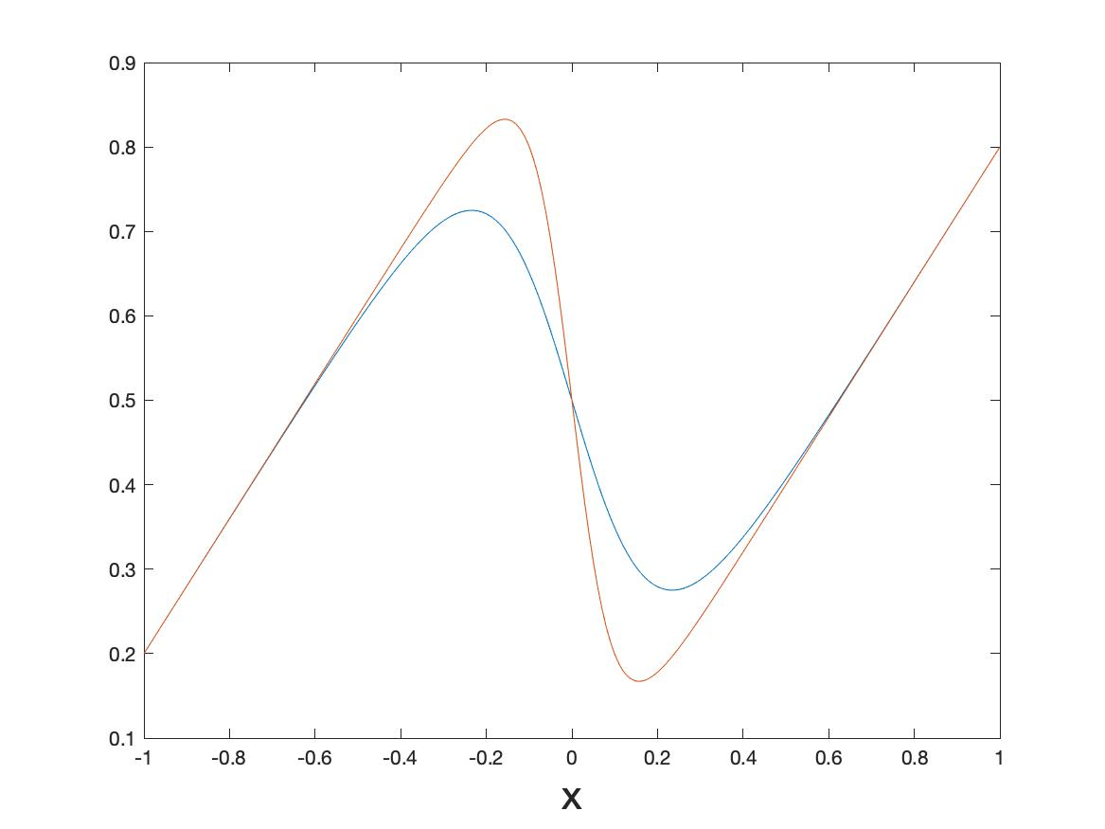
Case Study One: Feed forward NN: One-d smoothed sigmoid map
Smoothed to:
c = 10
c = 5

Slide 34
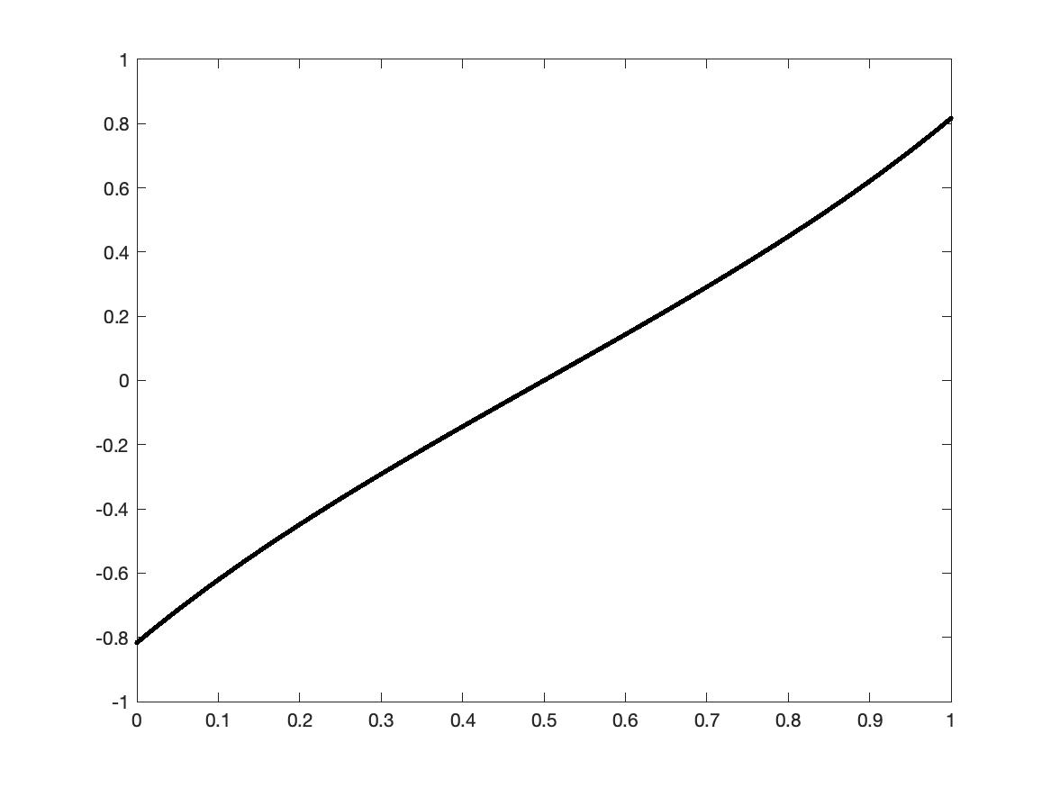
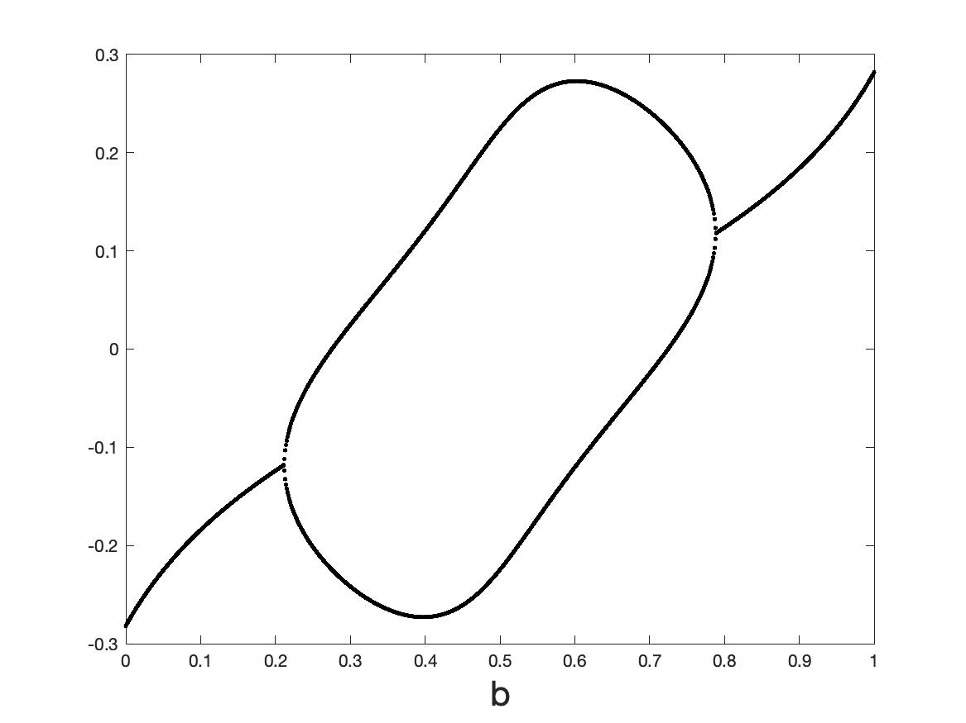
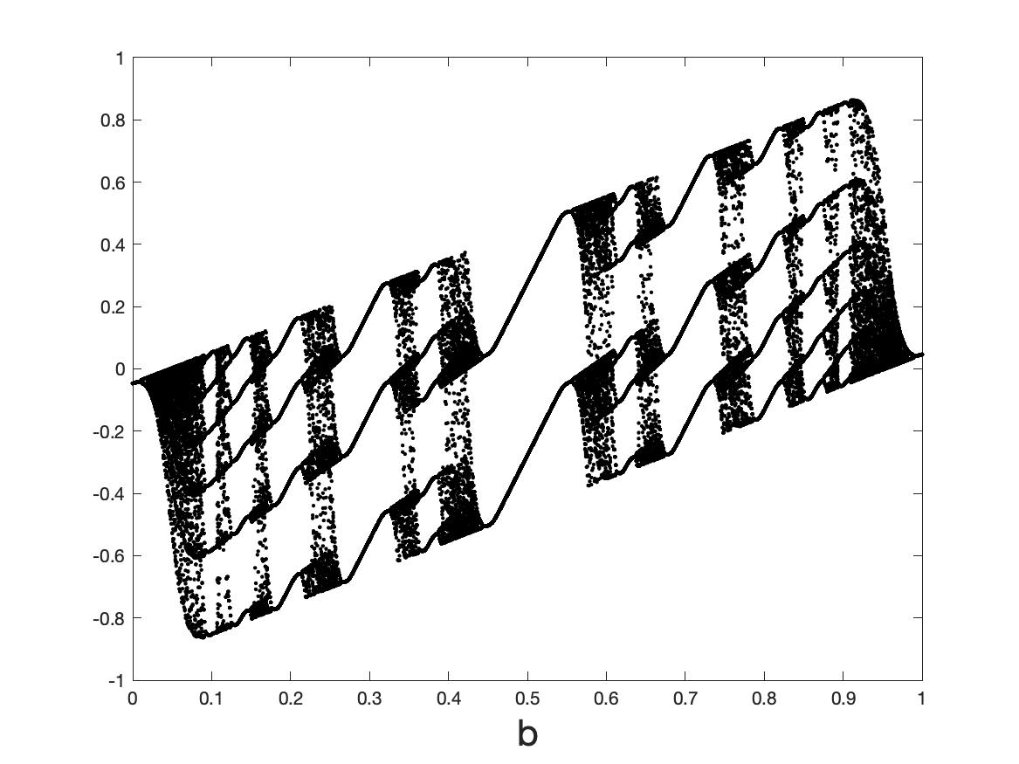
Omega-limit sets as a function of smoothing (when a = 0.8)
c = 1
c = 5
c = 10
c = 50
c = 1000
Border collision

Slide 35
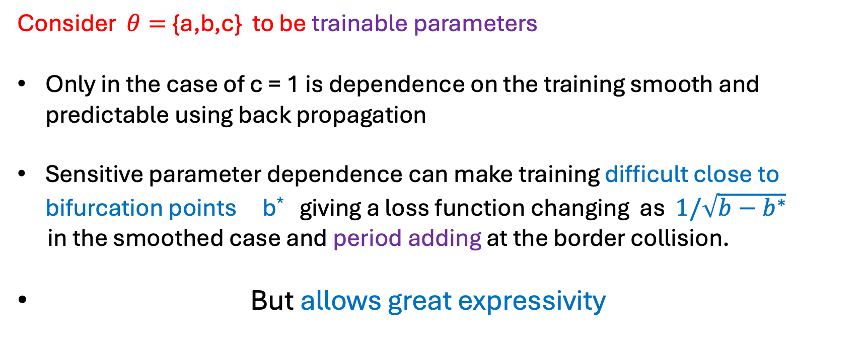
Conclusions from the results
High gradient of the tanh function leads to chaotic behaviour in certain cases. Hard to define a loss function and dependence of the loss function on the input/parameters in this case
Consider $θ=${a,b,c} to be trainable parameters
Only in the case of c = 1 is dependence on the training smooth and predictable using back propagation
Sensitive parameter dependence can make training difficult close to bifurcation points b* giving a loss function changing as $1/\sqrt{b−b^{∗}}$
in the smoothed case and period adding at the border collision.
But allows great expressivity

Slide 36

Classification [B et. al]: Suppose we have a sigmoid type NN of the form
Guide to what we might expect as we pass through a training process

Slide 37
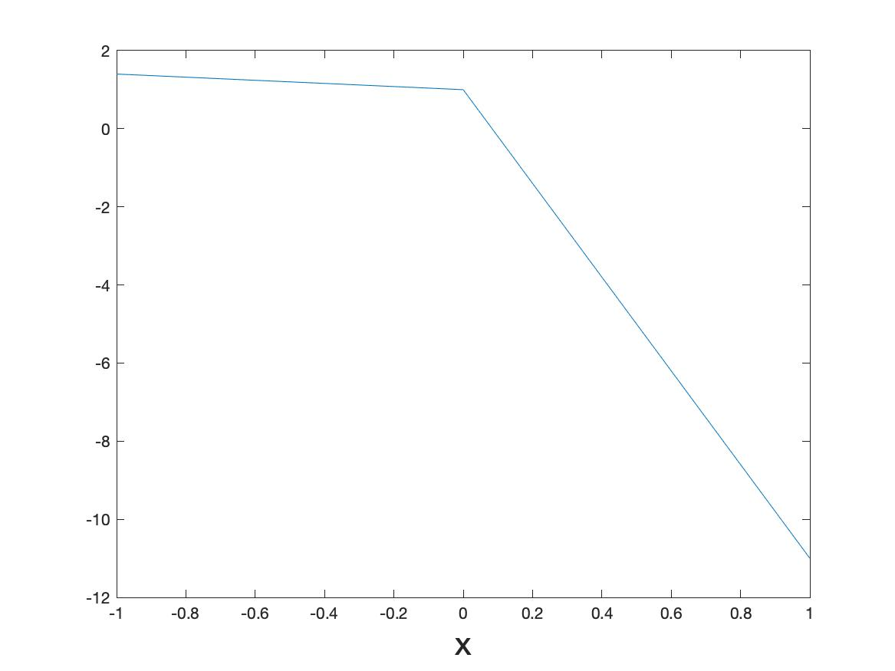
Case Study Two: One-d and two ReLu functions combined

Slide 38
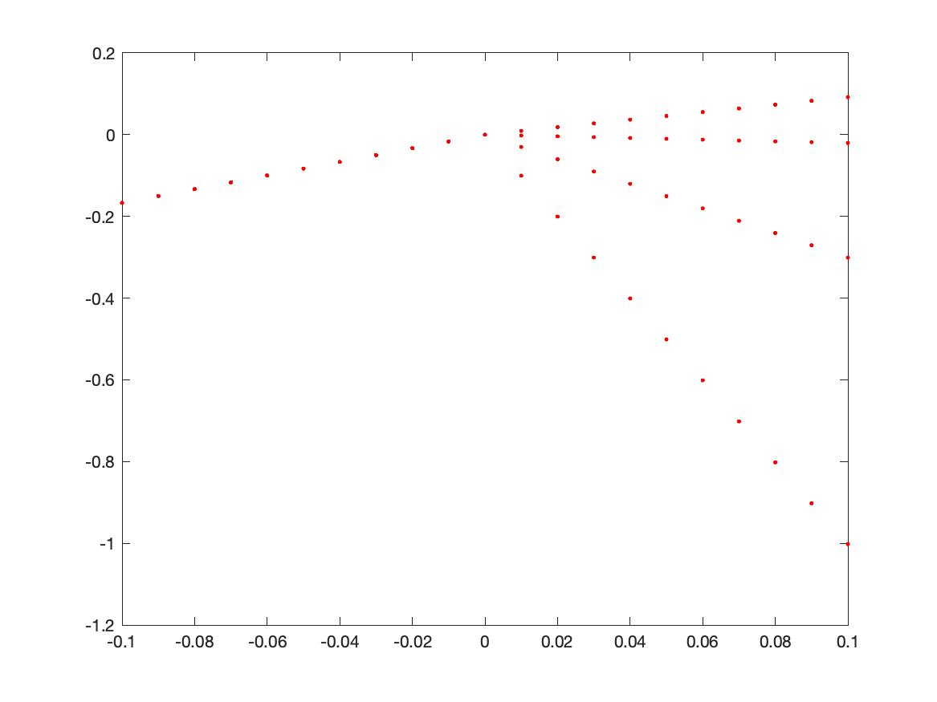
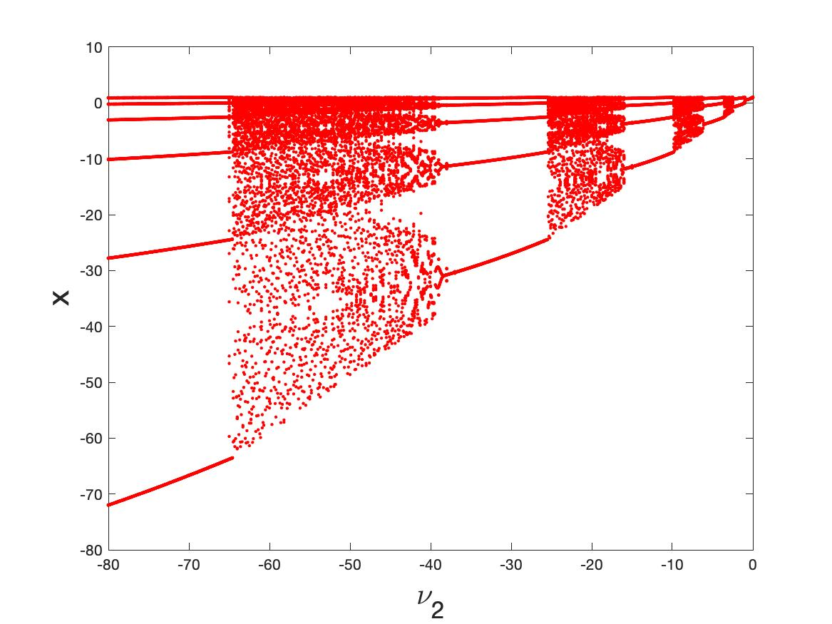
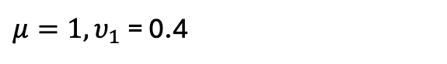
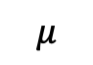
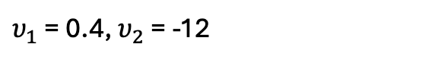
Omega-limit sets. $υ_{1}$ = 0.4
[Helena E. Nusse, ' Edward Ott, and James A. Yorke’,94]
$$μ$$
$υ_{1}$ = 0.4, $υ_{2}$ = -12
$μ=1, υ_{1}$ = 0.4

Slide 39
Comments (similar) on the ReLU dynamics
Dynamics is determined by the symbolic sequences of points lying L or R of x = 0
Observe both periodic cycles and robust chaotic behaviour
Bifurcations arise when a symbol crosses x = 0 at a border collision. This cannot be determined from a back propagation type of analysis
Get good expressivity. Need to consider how symbol sequences work for this
Can extend this naturally to higher dimensions but symbol sequences are much harder
Note that chaotic behavior is seen in ESNs as well [Ashwin et. al. ]

Slide 40
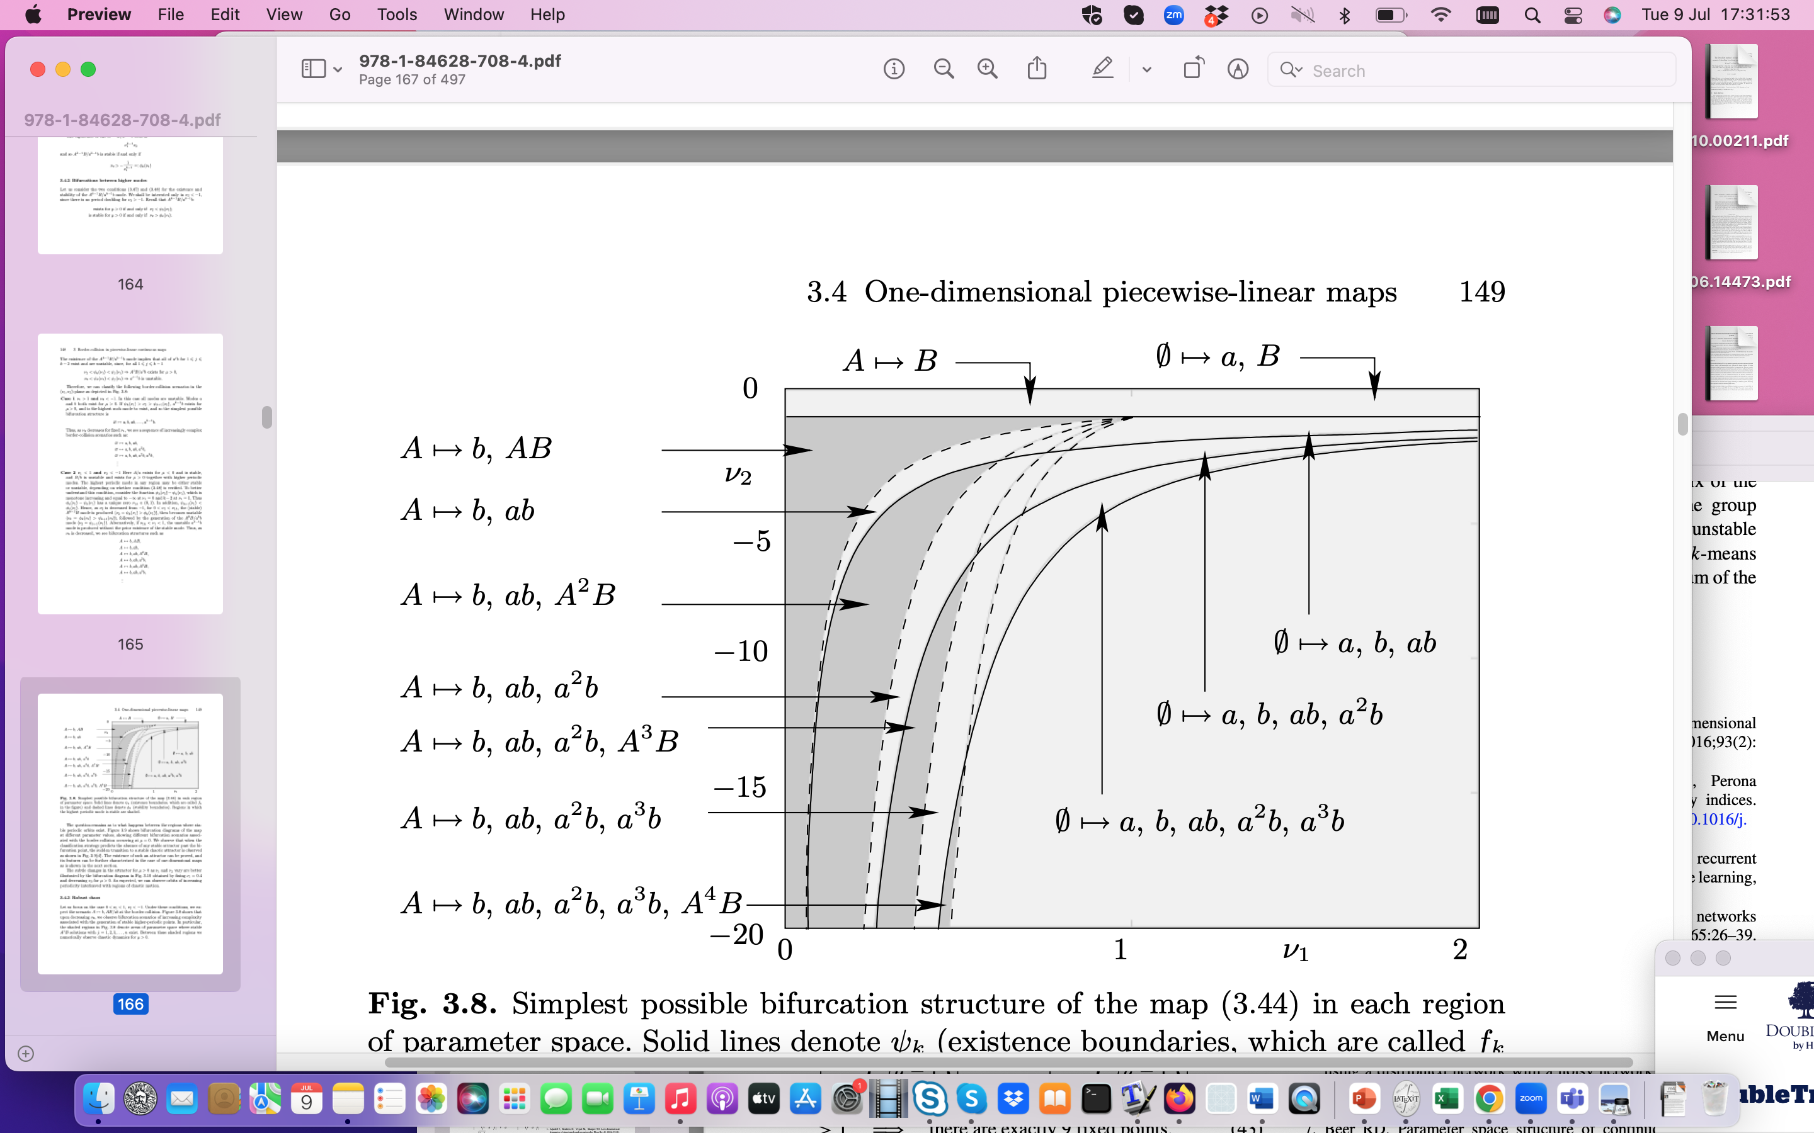
Classification: Suppose we have ReLU type NN of the form
A/a : Left of switch
B/b : Right of switch

Slide 41
Case Study 3: ‘Neural ODE’
Example 1: Border equilibrium bifurcation in a climate related NODE with a (smoothed) Heaviside activation function
Smoothed

Slide 42
Filippov dynamical system without sliding
Typical ‘transverse’ intersection

Slide 43
Unforced system (Heaviside)
Two Fixed points
Physical
Virtual

Slide 44
Theorem
There exist critical values of the parameter d
If fixed point is physical and globally attracting
If fixed point is physical and globally attracting
If see a periodic solution
Transitions occur at Border Collision Bifurcations when

Slide 45
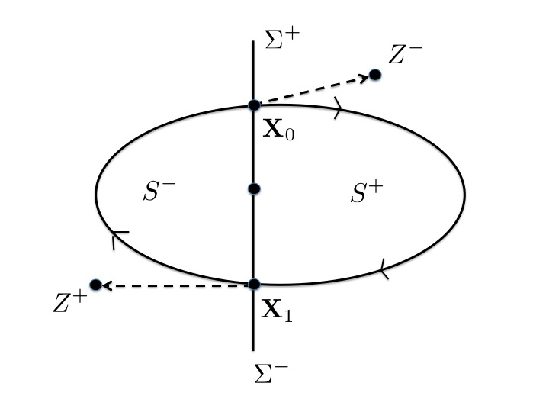
Existence of a periodic orbit
Virtual
F(X) > 0
F(X) < 0
Virtual
: F(X) = 0
Proof using the Brouwer Fixed Point. theorem

Slide 46
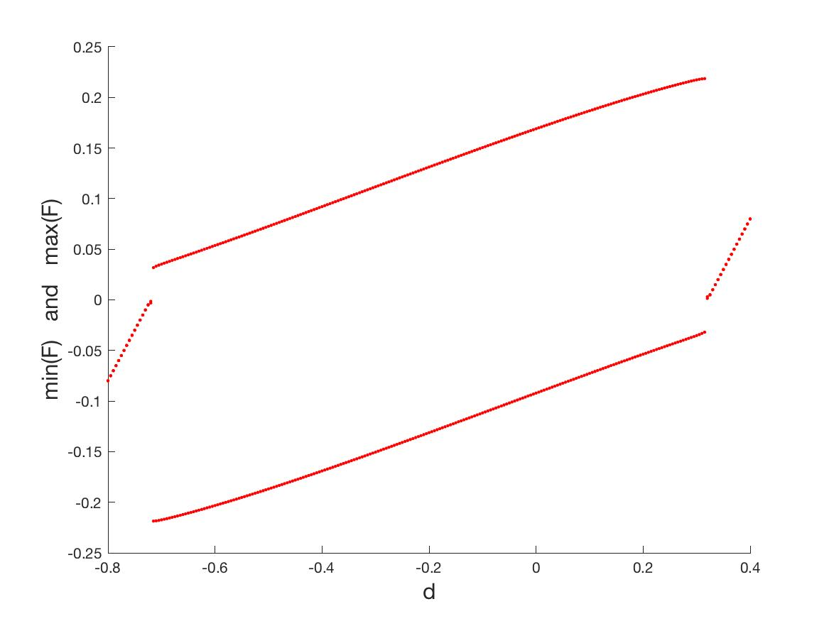
Bifurcation diagram: Heavyside
Periodic
Fixed point
Border collision bifurcation
Fixed point
$$η=10000$$

Slide 47
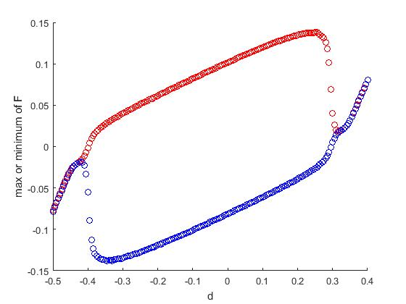
Bifurcation diagram: (smoothed) tanh
Periodic
Fixed point
Sub-critical Hopf bifurcation
Fixed point
$$η=100$$

Slide 48
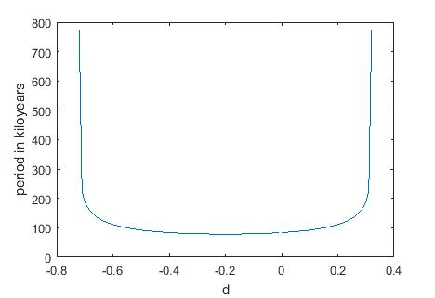

Slide 49
Example 2: Fixed point, Limit Cycle, and Chaotic Dynamics in ReLU type ODEs
(+,+)
(+,0)
(0,+)
(0,0)

Slide 50
Evolution of a fixed point. (2-dimensions)
Back propagation OK
FP
Back propagation fails

Slide 51
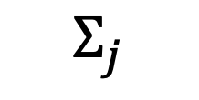
Local behaviour (n – dimensions) when back propagation fails
c^{T} x = d
$$Σ_{j}$$

Slide 52
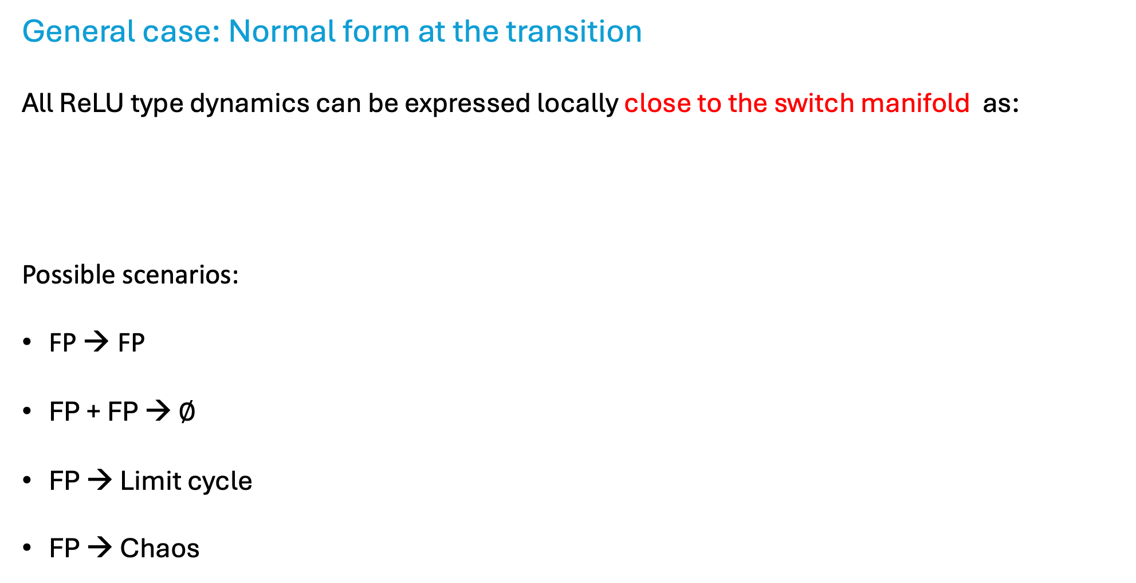
General case: Normal form at the transition
All ReLU type dynamics can be expressed locally close to the switch manifold as:
Possible scenarios:
FP → FP
FP + FP → $∅$
FP → Limit cycle
FP → Chaos
Can classify many of the transitions in terms of the structure of A_{i} and b.
[Freire], [Carmona]

Slide 53
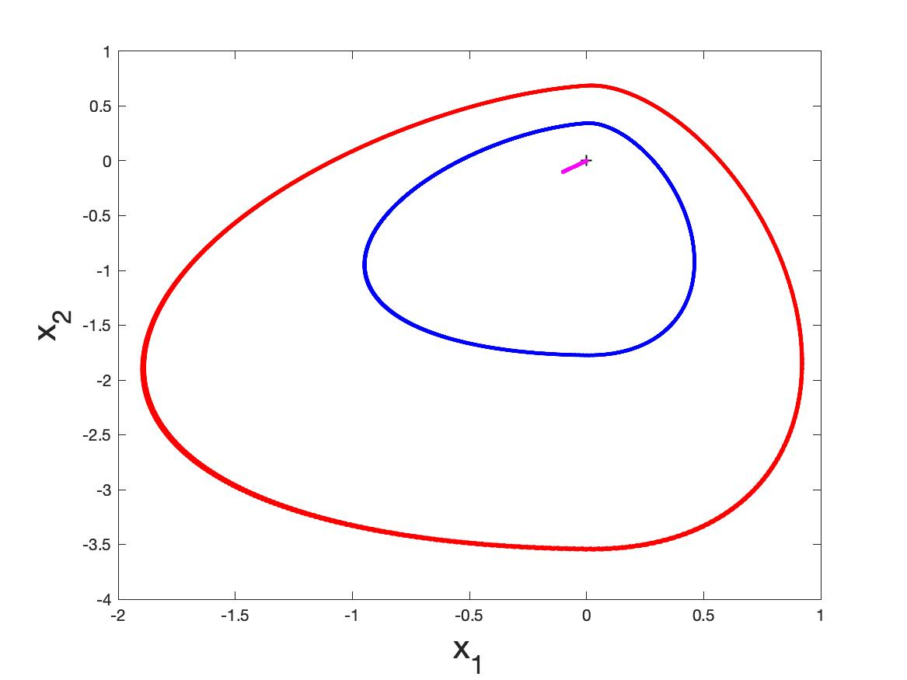
Example: FP → Limit Cycle

Slide 54
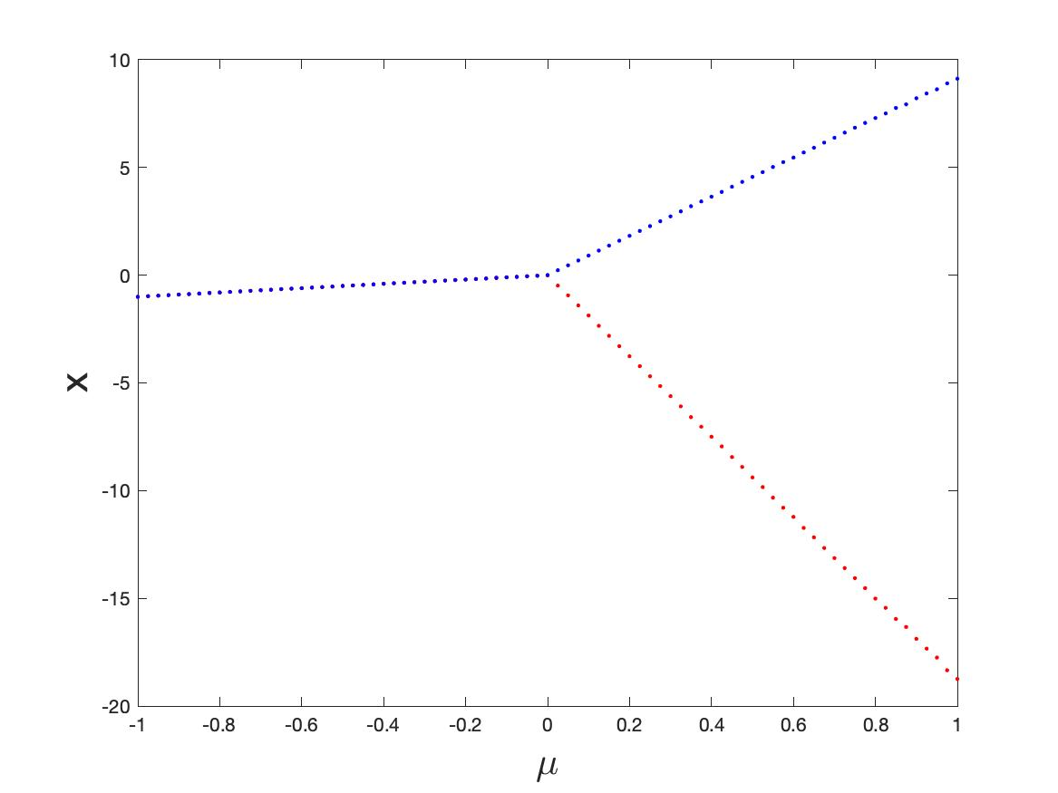
Max(x)
Fixed point
Min(x)
Limit cycle

Slide 55
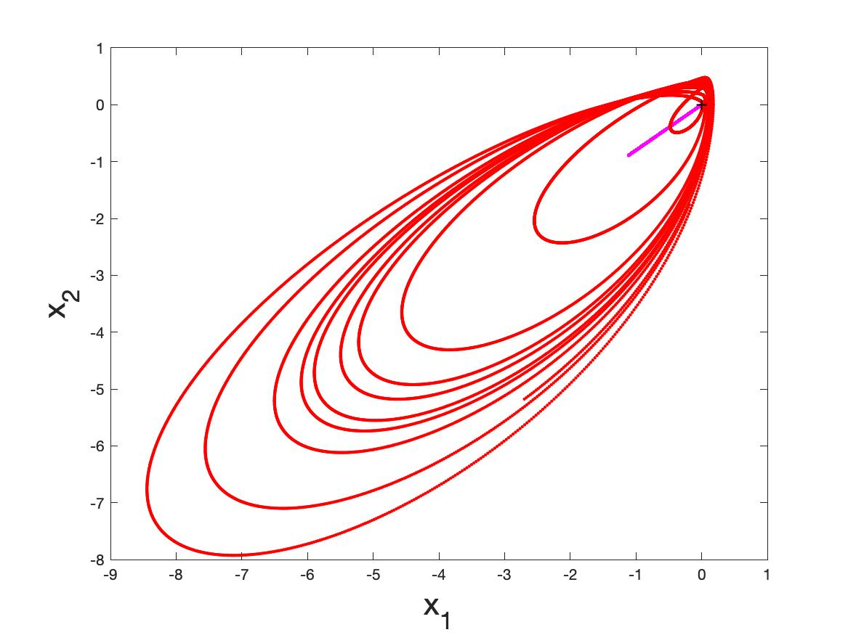
Example 2: FP → Chaos

Slide 56
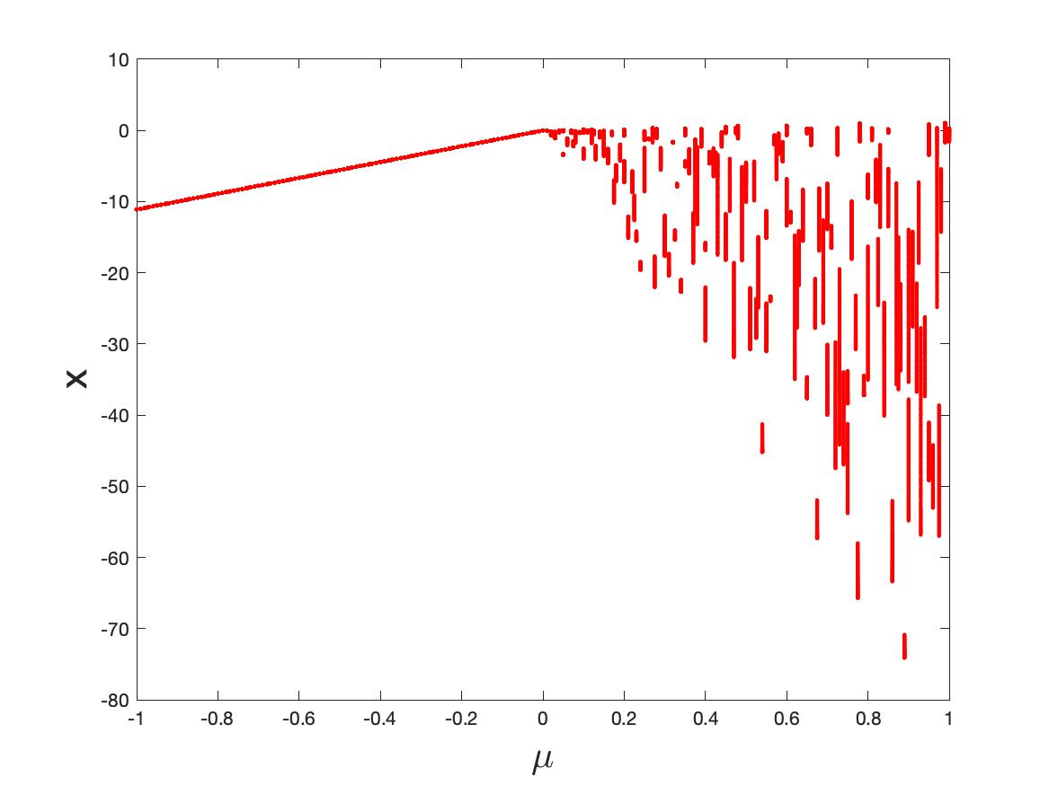
Fixed point
Chaos

Slide 57
Davide material here

Slide 58
Conclusions and Next Steps
Have demonstrated that typical activation functions can lead to complex (FP, Periodic, chaotic) in feed forward NN and neural ODEs
Can classify certain complex behaviour at transition points where back propagation breaks down
Need to test on realistic ML architectures with multiple switching surfaces
Need to understand how identifying NSD structures might improve training and control as discontinuity manifolds are crossed

Slide 59
References
H. Nusse, E. Ott, and J. Yorke. Border collision bifurcations: an explanation for observed bifurcation phenomena. Phys. Rev. E, 49:1073–1076, 1994.
Mario Di Bernardo, B. , et. al. ‘Piecewise smooth dynamical systems: theory and applications’, Springer 2008
Igor Belykh, Rachel Kuske, Maurizio Porfiri, and David J. W. Simpson, ‘Beyond the Bristol book: Advances and perspectives in non-smooth dynamics and Applications, 2023
E. Freire, E. Ponce, F. Rodrigo, and F. Torres. ‘Bifurcation sets of continuous piecewise linear systems with two zones’. International Journal of Bifurcation and Chaos, 8(11):2073–2097, 1998.
V. Carmona, E. Freire, E. Ponce, and F. Torres. Bifurcation of invariant cones in piecewise linear homogeneous systems. International Journal of Bifurcation And Chaos, 15(8):2469–2484, August 2005.
Andrea Ceni, Peter Ashwin, Lorenzo Livi, ‘Interpreting Recurrent Neural Networks Behaviour via Excitable Network Attractors’, Cognitive Computation (2020) 12:330–356

